Slide 1

HOUSING: PRICE PREDICTION
By : Umesh Rajendra Mahajan
Batch : 32

Slide 2
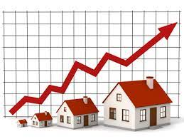

Slide 3
What is House price predication ?
House Price Index (HPI) is commonly used to estimate the changes in housing price. Since housing price is strongly correlated to other factors such as location, area, population, it requires other information apart from HPI to predict individual housing price. There has been a considerably large number of papers adopting traditional machine learning approaches to predict housing prices accurately, but they rarely concern about the performance of individual models and neglect the less popular yet complex models. As a result, to explore various impacts of features on prediction methods, this paper will apply both traditional and advanced machine learning approaches to investigate the difference among several advanced models. This paper will also comprehensively validate multiple techniques in model implementation on regression and provide an optimistic result for housing price prediction.

Slide 4
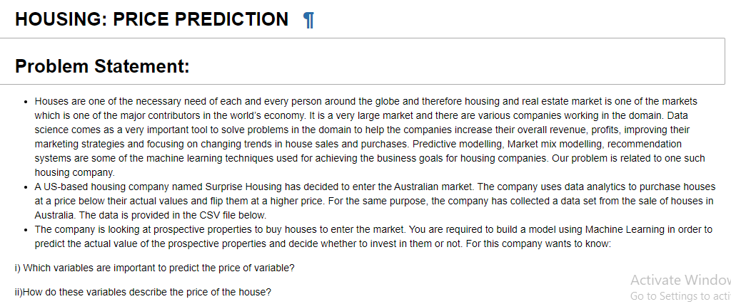

Slide 5
Topics covered :
Overview.
Problem Understanding
What is Housing Price Prediction?
Importance of housing price prediction.
Exploratory data analysis.
Visualizations.
Analysis.
Data cleaning steps
Model Building.
Hyper Parameter Tunning.
Saving the model and predictions from saved best model.
Conclusion.

Slide 6

How does how price predication help in real life
Predicting house prices can help to determine the selling price of a house of a particular region and can help people to find the right time to buy a home.

Slide 7
EDA- Exploratory Data Analysis
Shape – By using shape feature I got to know there are 1168 rows and 81 columns in dataset.
Columns –Using columns function I am able to review name of columns.
Datatypes – I found there are objects present in data set which is not acceptable by ML models hence we need to encode them.
Unique – Using unique I am able to understand how much unique values present in data set. If every value is unique them I have dropped those Columns.
Isnull – Using this method I was able to see after there are null values present or not

Slide 8
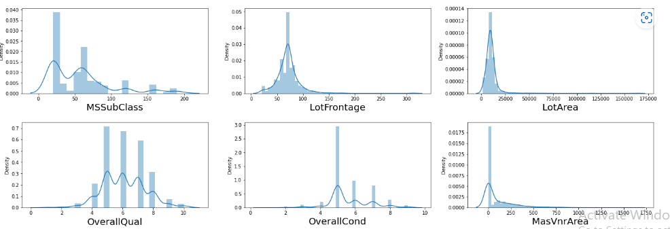
Visualization :
Univariate analysis

Slide 9
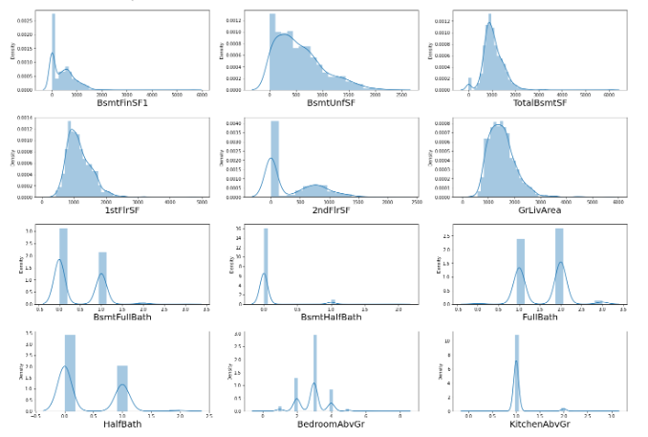

Slide 10
Observation
We can see that of each column is distributed.
Lot area is shifted toward left side,
GrlivAre looks some symmetrical distribution.
BSmthalfBath most of data spreaded in range of 0 only.
GarageArea is good distribution as compare to other.
There are very less number who sold their how above range of 400000.
Year_sincesold max data fall between range of 1 to 4

Slide 11
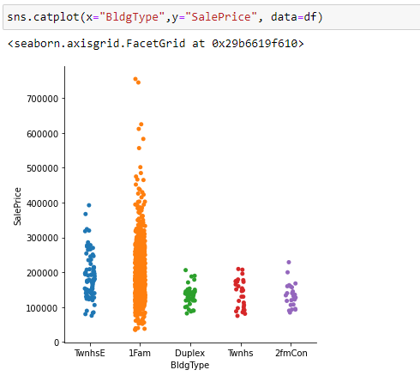
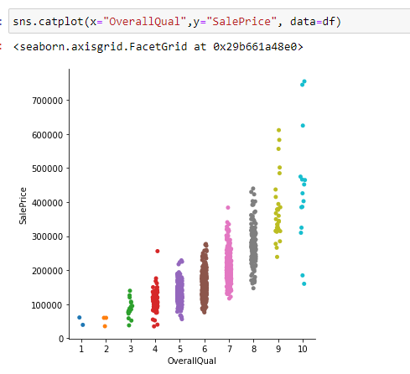
Bivariate analysis
I have tried to see relation with target variable

Slide 12
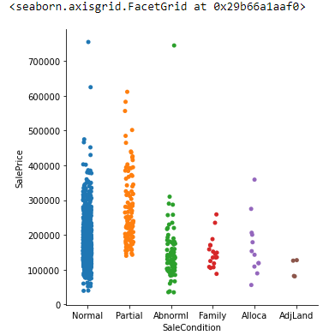
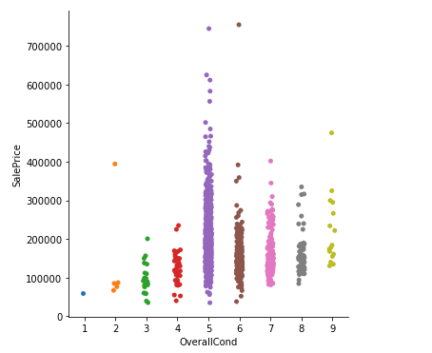
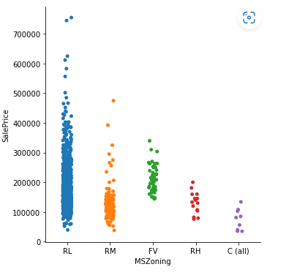
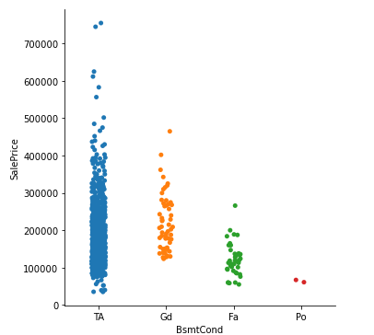

Slide 13
Observation
Sales price are high in TwnhsE,Ifam highest we can see in Ifam for other three category has almost same value.
Salesprice and OverallQual has positive liner relation we can see price increased as soon as increased number of OverallQual.
OverallCond 5 has highest saling price and 1 has lowest shows some liner relation
SaleCondition “Normal” and “partial” has high chance of good saleprice
Most of house sold by RL category in MSZoning
“Ex” from HeatingQC has high rate recorded.

Slide 14
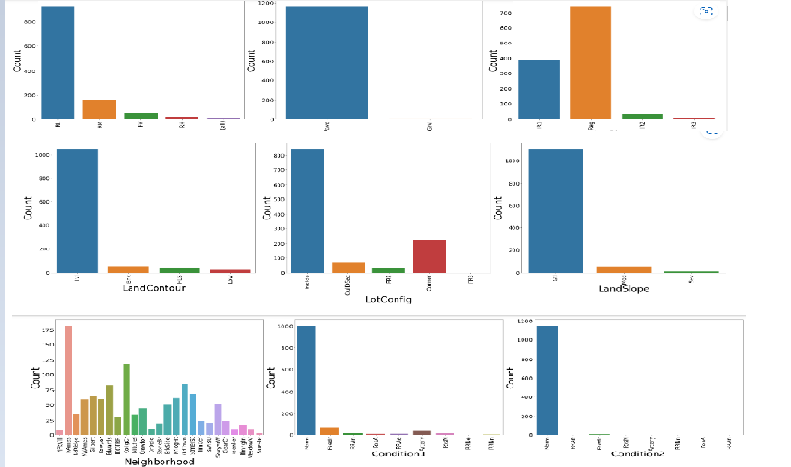
Count Plot

Slide 15
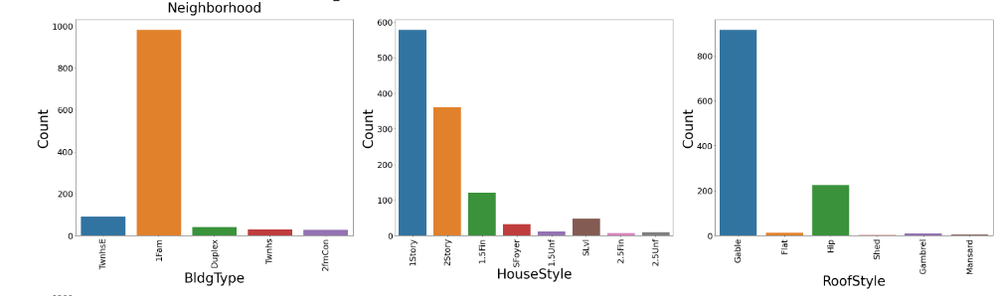
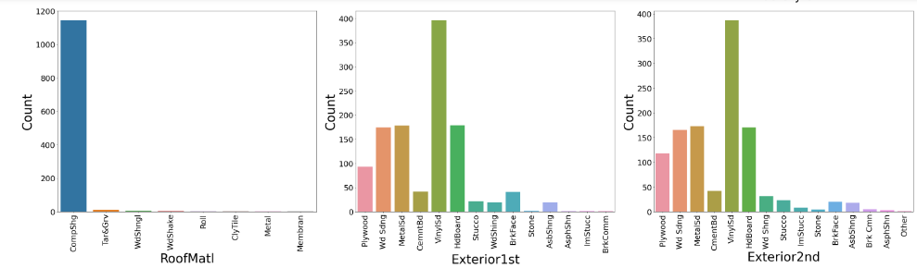
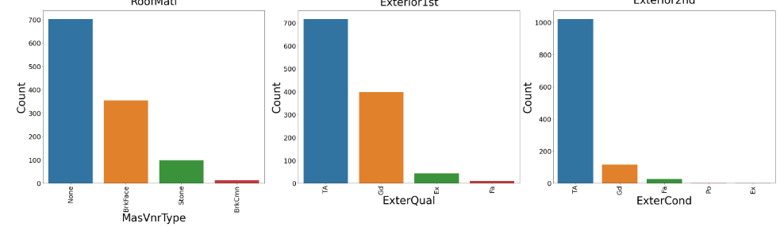

Slide 16
Observation :
RL has maximum count in MSzoning and C all has very low sontribution.
street Pave looks famous Street as count is high.
Lotshape Reg has highest count in all shape.
LandContour Lvl has highest count and low is very less.
Housestyle 1story is maximum preferrence and 25story is second largest.
Roofstyle Hip and Gable is the most preferred styles.
Roofmati compshg is the most high used type.
C block and PConc are most used in Foundation.
Most of the housed are having CentralAir system.
KitchenQual TA and gd are famous one

Slide 17
Outliers
Outliers can give helpful insights into the data you're studying, and they can have an effect on statistical results. This can potentially help you discover inconsistencies and detect any errors in your statistical processes.
So, knowing how to find outliers in a dataset will help you better understand your data.

Slide 18
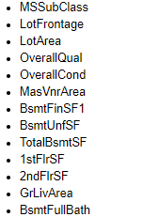
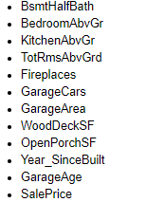
We have removed outliers from below columns using Percentile Method:

Slide 19
Data Preparation before model building
There was skewness present in data for some column I have removed skewness using yeo-johnson.
Identified and dropped some unnecessary columns.
Converted object in to numeric format using ordinal Encoding.
Reviewed correlation of all columns with target columns.
Defined X and Y.
Scaled our data with standard scaler.
Identified multicollinearity using VIF and removed high VIF values

Slide 20
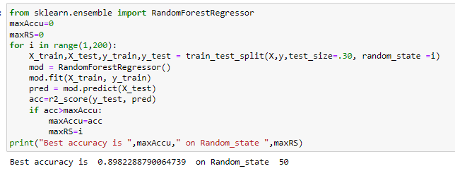
Found best random state

Slide 21

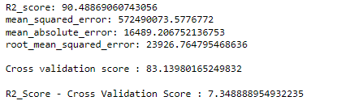
Finally Build multiple models to find best model

Slide 22

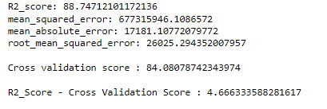

Slide 23

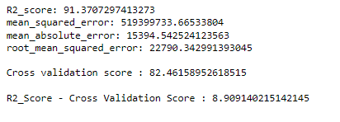

Slide 24

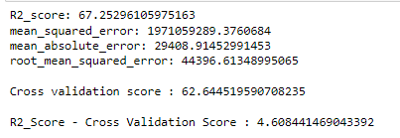

Slide 25
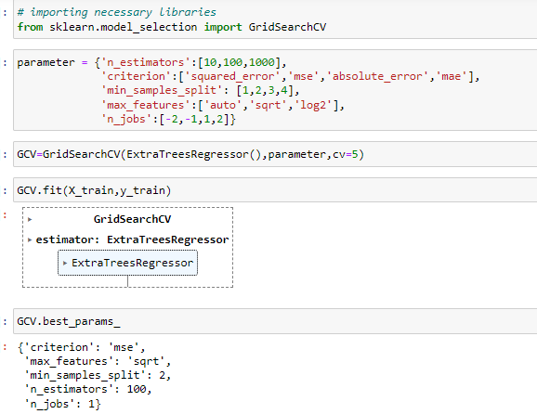
Looking at all above matrix for different model I have selected ExtraTreesRegressor model as best model because it has very less difference between accuracy score and cross validation score.
Hyperparameter tunning for best model

Slide 26
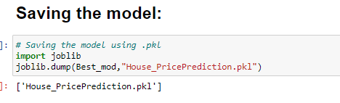
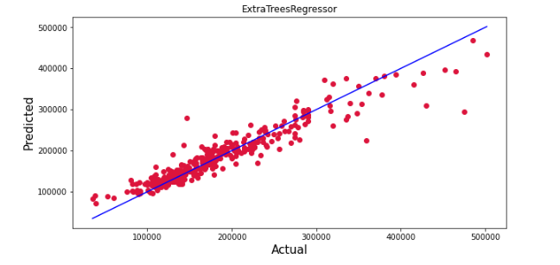
We got 88 % Accuracy after tunning hyperparameter and finally I have saved my best model.
Below is the line which shows that pink dots are predicated values and they are very close to blue line
which is actual value

Slide 27
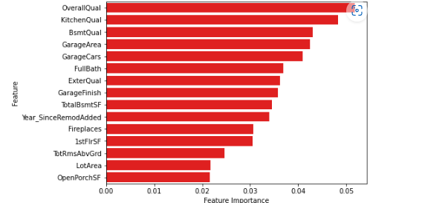
Below are the important features identified in Dataset

Slide 28
Conclusion:
In this project report, we have used machine learning algorithms to predict the house prices.
We have mentioned the step by step procedure to analyze the dataset and finding the correlation between the featuers. Thus we can select the features which are not correlated to each other and are independent in nature.
Those feature sets were then given as an input to five algorithms and a csv file was generated consisting of predicted house prices.
Hence we calculated the performance of each model using different performance metrics and compared them based on these metrics. Then we have also saved the dataframe of predicted prices of test dataset.
To conclude, the application of machine learning in property research is still at an early stage. We hope this study has moved a small step ahead in providing some methodological and empirical contributions to property appraisal, and presenting an alternative approach to the valuation of housing prices.
Future direction of research may consider incorporating additional property transaction data from a larger geographical location with more features, or analysing other property types beyond housing development.

